Slide 1

Year Four
Day of the Week | Activity
Monday | Rock, Paper, Scissors – Duel!
Tuesday | Gymnastics Routine
Wednesday | 30 or Under
Thursday | Heart Rate Challenge
Friday | Joe Wicks – Fancy Dress Style

Slide 2
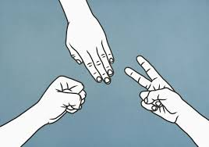
Monday – Rock, Paper, Scissors – Duel!
Find someone to play against. Challenge them to a game of Rock, Paper, Scissors whoever wins gets to decide a physical forfeit for their opponent!

Slide 3
Tuesday –Gymnastics routine!
We know you might be a little squished for space at the moment, but on Tuesday’s your challenge is to create your own Gymnastics challenge. Aim for 4-5 balances completed in succession.
You may not be able to perform a Round off – but you can practice these point balances.
Remember Gymnastics judges appreciate, Control, Extension and Fluency. So tense those muscles to stay nice and still and extend your arms, legs, fingers and toes where possible!

Slide 4
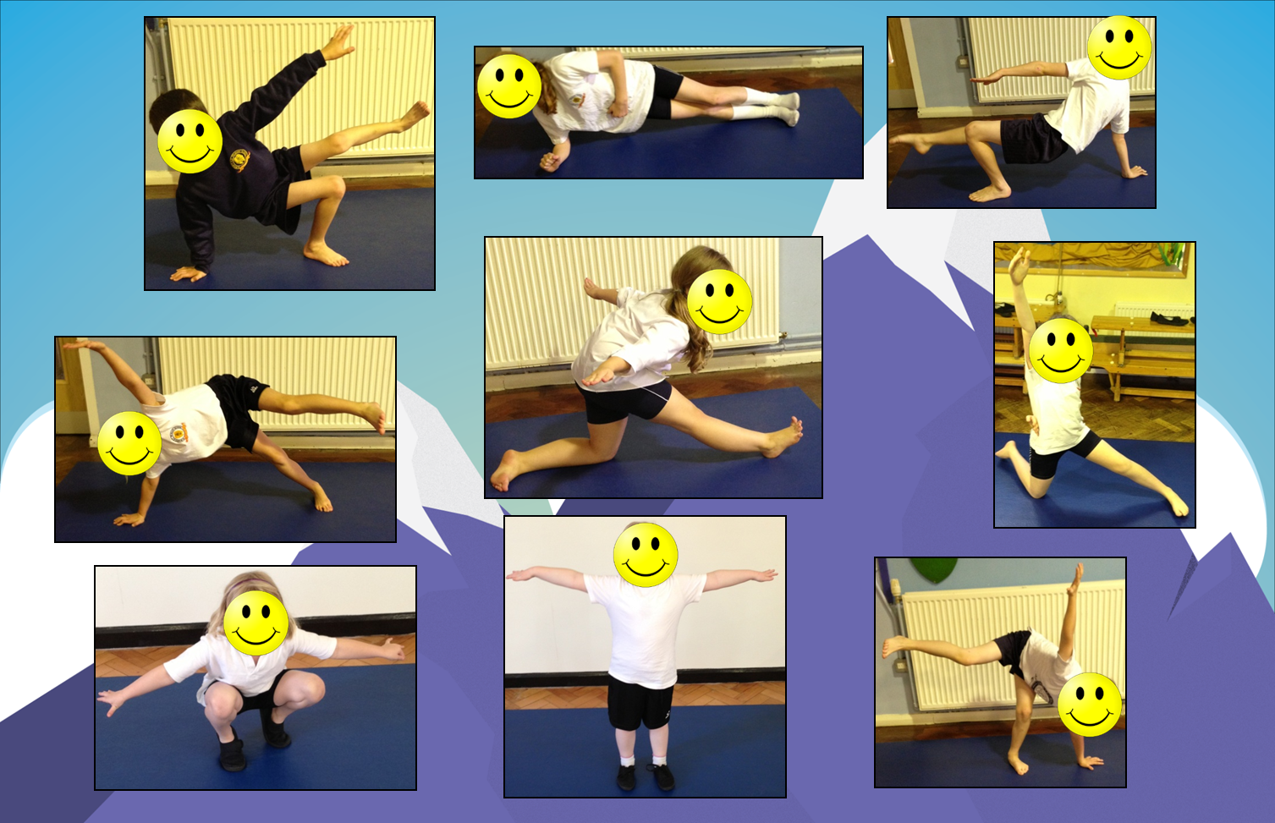
2 Point Balances

Slide 5
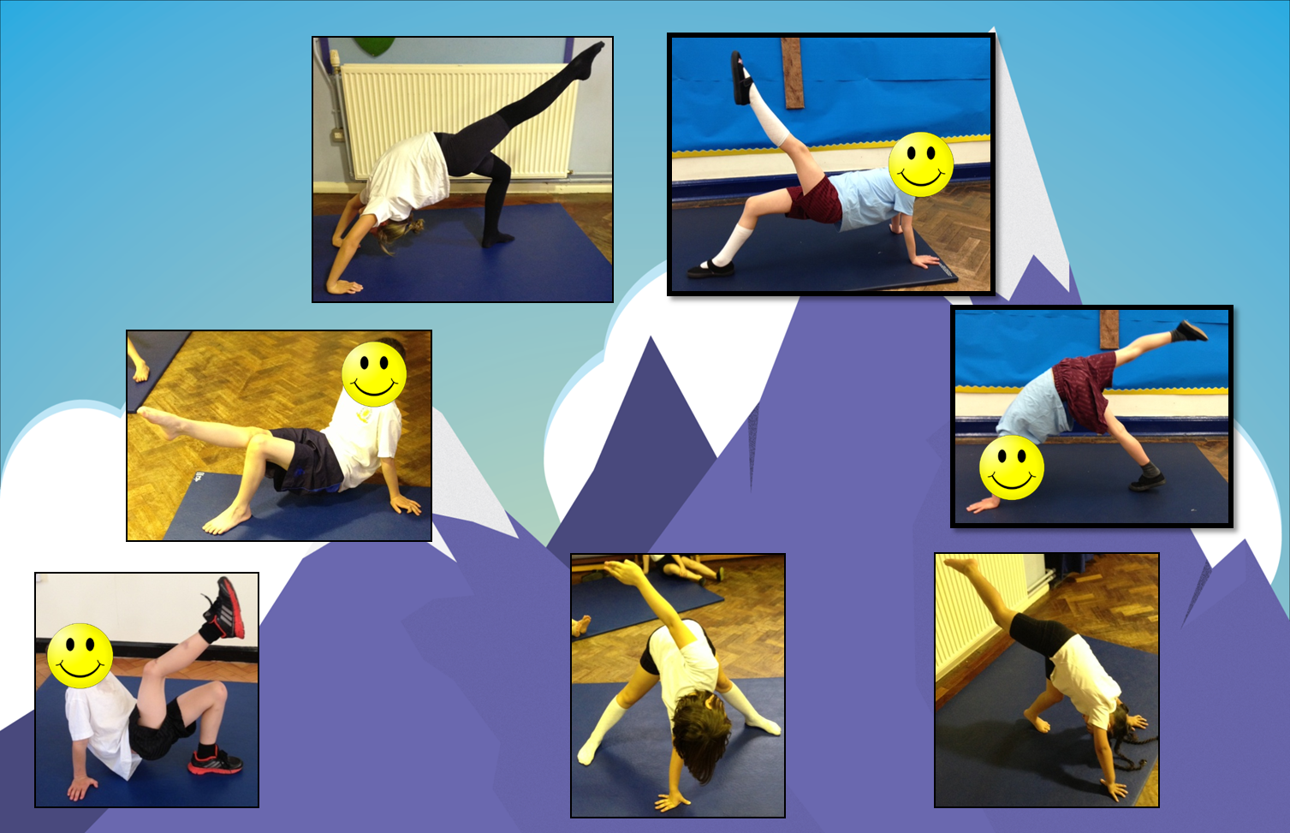
3 Point Balances

Slide 6
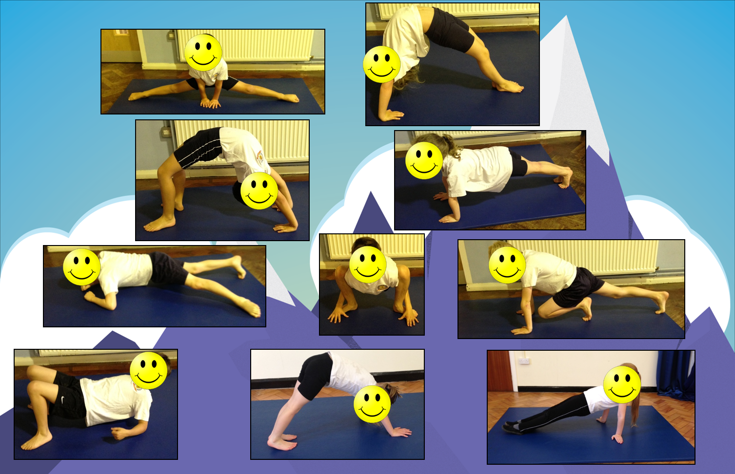
4 Point Balances

Slide 7
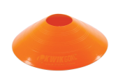
Wednesday – 30 or under
Pick a sport that you enjoy (and that you have the equipment for). It could be Hockey, Basketball or Football.
Set out 2 markers, the challenge is to dribble ‘there and back’ in under 30 seconds. If you can do it, add another marker and weave in and out!
If you can do it – make it harder for yourself!

Slide 8
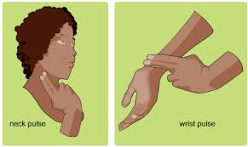
Thursday – Heart Rate Challenge
Today you will conduct a science experiment!
As you know you heart rate (how fast your heart beats) changes depending on how your body is moving.
On Thursdays you need to try lots of different types of exercise, the challenge is to see how fast you can make your heart beat!
There is one rule – you just complete the exercise for at least 2 minutes before you take your pulse. Then simply fill out the log on the sheet (or copy it and write it down on some scrap paper). Enjoy!

Slide 9
Type of Activity | Heart Rate (How fast your heart is beating)

Slide 10
Friday – Joe Wicks Fancy Dress
On Friday Joe Wicks encourages people to dress up and join in with his online work outs.
Dress up and get moving. Enjoy!
https://www.youtube.com/user/thebodycoach1

