Slide 1
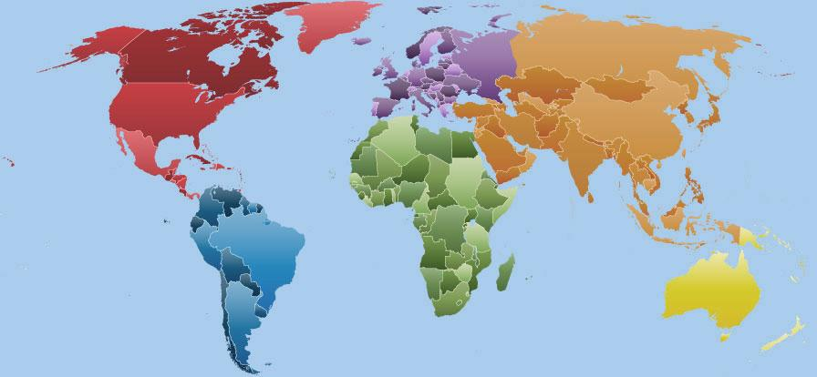
Click on the continent you want to find out about...

Slide 2

Africa
Area | 30 065 000 sq km
Population | 877 500 000
Number of Countries | 53
Largest Country (Area) | Algeria (2 381 741 sq km)
Smallest Country (Area) | Seychelles (455 sq km)
Largest Country (Population) | Nigeria (162 471 000)
Smallest Country (Population) | Seychelles (90 945)
Highest Point | Kilimanjaro, Tanzania (5 895 m)
Lowest Point | Lake Assal, Djibouti (-156 m)
Hottest Temperature | 57.8 °C (‘Aziziya, Libya)
Coldest Temperature | −24 °C (Ifrane, Morocco)

Slide 3
Asia
Area | 44 579 000 sq km
Population | 3 879 000 000
Number of Countries | 44
Largest Country (Area) | Russia (17,098,242 sq km)
Smallest Country (Area) | Maldives (298 sq km)
Largest Country (Population) | China (1 347 350 000)
Smallest Country (Population) | Maldives (317 280)
Highest Point | Mt Everest, Nepal-China (8850 m)
Lowest Point | Dead Sea, Israel-Jordan (-417.5 m)
Hottest Temperature | 53.9 °C (Tirat Tsvi, Israel)
Coldest Temperature | −68 °C (Oymyakon, Russia)

Slide 4
Europe
Area | 9 938 000 sq km
Population | 727 000 000
Number of Countries | 47
Largest Country (Area) | Russia (3 983 042 sq km)
Smallest Country (Area) | Vatican City (0.44 sq km)
Largest Country (Population) | Germany (81 859 000)
Smallest Country (Population) | Vatican City (800)
Highest Point | Elbrus, Russia (5 642 m)
Lowest Point | Caspian Sea, Azerbaijan (-28 m)
Hottest Temperature | 48.0 °C (Athens, Greece)
Coldest Temperature | -58.1 °C (Ust’ Shchugor, Russia)

Slide 5
North, Central America & the Caribbean
Area | 24 256 000 sq km
Population | 501 500 000
Number of Countries | 23
Largest Country (Area) | Canada (9 984 670 sq km)
Smallest Country (Area) | St. Kitts & Nevis (261 sq km)
Largest Country (Population) | United States (313 723 000)
Smallest Country (Population) | Caribbean Netherlands (21,133)
Highest Point | McKinley, Alaska (6 194 m)
Lowest Point | Death Valley, California (-86 m)
Hottest Temperature | 56.7 °C (Death Valley, US)
Coldest Temperature | −66.1 °C (N. Ice, Greenland)

Slide 6
South America
Area | 17 819 000 sq km
Population | 379 500 000
Number of Countries | 12
Largest Country (Area) | Brazil (8,514,877 sq km)
Smallest Country (Area) | Suriname (163,820 sq. km)
Largest Country (Population) | Brazil (192 376 496)
Smallest Country (Population) | Falkland Islands (3 000)
Highest Point | Aconcagua, Argentina (6 960 m)
Lowest Point | Laguna del Carbon, S. Cruz (-105 m)
Hottest Temperature | 49.1 °C (Villa de Maria, Argentina)
Coldest Temperature | −39 °C (San Juan, Argentina)

Slide 7
Oceania/Australia
Area | 7 687 000 sq km
Population | 32 000 000
Number of Countries | 14
Largest Country (Area) | Australia (7 741 220 sq. km)
Smallest Country (Area) | Tokelau (12 sq. kms)
Largest Country (Population) | Australia (22 932 091)
Smallest Country (Population) | Pitcairn Islands (66)
Highest Point | Puncak Jaya, N. Guinea (5 040 m)
Lowest Point | Lake Eyre (-12 m)
Hottest Temperature | 50.7 °C (Oodnadatta, Australia)
Coldest Temperature | −25.6 °C (Ranfurly, N. Zealand)

