Slide 1
To write an information text about the digestive system.
To identify the features of an information text.

Slide 2
What are the key features of an information text?
Which features can we identify?

Slide 3

Key features:
Specific content
Headings and sub-headings
Address the reader (e.g did you know?)
Expanded noun phrases
Pictures, images and captions
Adverbs and adverbials of time/manner/place
Technical vocabulary/glossary
Key information

Slide 4
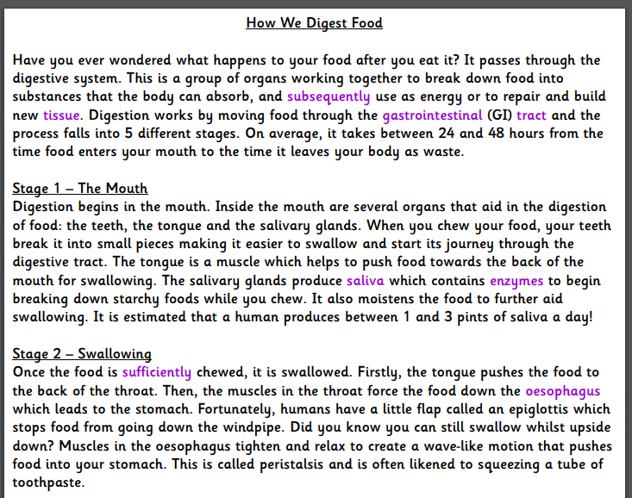

Slide 5
Your turn
In the intestine:
After several hours, the stomach passes a thick liquid called chyme (dissolved food) onto the small intestine. The highly-efficient intestines are able to break this down further using enzymes and this is where nutrients are absorbed into the bloodstream. Other organs (pancreas, gall bladder and liver) also assist the absorption of important nutrients, such as protein, fats, carbohydrates and minerals. The small intenstine is coiled like a hose and is usually around 7 metres long when it is stretched out!
Next, the chyme travels to the large intestine, also known as the colon. This is the final stage of the digestion process and is where remaining water is absorbed from the indigestible food. Any food that the body cannot use forms faeces, which is stored in the rectum until it is ready to excreted from the body, through the anus.
Overall, the digestive system is an incredibly important part of our body and without it, we would not receive the essential nutrients that our body needs to grow properly and stay healthy. It is vital for our health and well-being that our digestive system remains healthy. Therefore, it is crucial that our body receives enough water and a balanced diet, to ensure steady growth and an active lifestyle.

Slide 6
Introduction paragraph example
Have you ever wondered what happens to your food after you’ve eaten it? Your body is amazing and has a system called the digestive system, which sorts and uses the food you eat to ensure that your body is able to function properly. The essential system helps our bodies to work effectively because it takes the key nutrients and vitamins and moves them around our bodies. Many of the body’s organs contribute to the digestion of food, enabling steady growth and an active lifestyle.

